Slide 1
What can you see? (Big items)
What can you hear?
What can you smell?
What can you see? (Fine detail)

Slide 2
Precise nouns
Adjectives
5 senses : see, hear, touch, taste, smell
Where? Prepositional phrases, e.g. under the window, in the distance, beyond the woods.
What is the character thinking? How is the character feeling?
Action? Movement? Other characters?

Slide 3
Description (5 senses, where, prepositions)
Dialogue
Similes, metaphors & personification
Precise nouns and noun phrases
Time / day / season - Passage of time
Vivid verbs and adverbials
Rhetorical questions. Thoughts / feelings of character. Why are they there?
Action

Slide 4
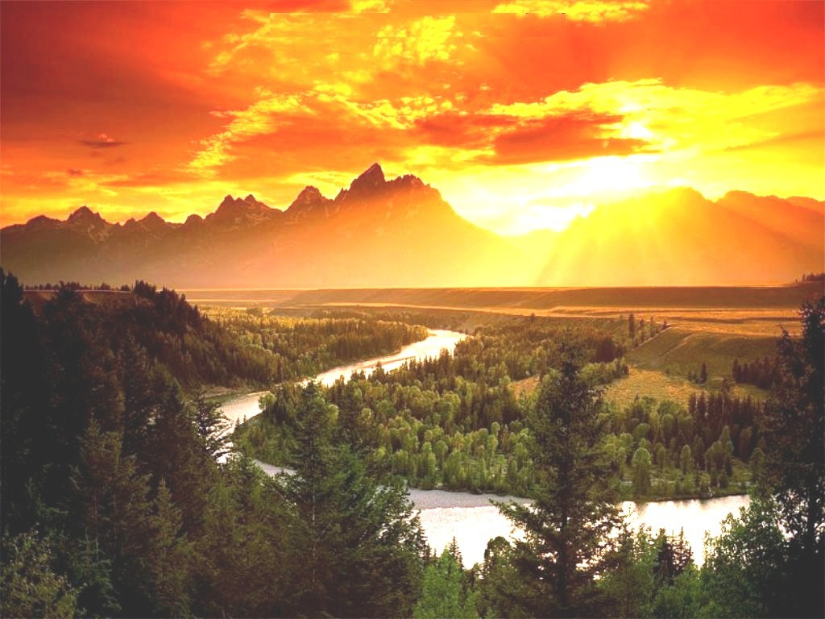
Description (5 senses, where, prepositions)
Dialogue
The jagged peaks of the mountain range were silhouetted in the distance.
The shimmering silver lake slithered through the valley, snaking from the foot of the mountains to become a roaring torrent below them.
“I think we should make camp here,” said Harold, taking off his heavy backpack and rubbing his shoulders. He squinted out across the horizon, “It’s at least a day’s walk to the foot of Mount Kiri from here.”
“Agreed. I don’t think trying to cross the forest at night would be wise,” I replied, grateful that we would walk no further.
The evening sun streaked over the mountain in shards of vivid yellow and bright white, like flames bursting from the mouth of a dragon; and from its quivering nostrils came clouds of burnt amber that filled the sky..
Similes, metaphors & personification
Pine trees, silver snake river, mountain range, green plains, jagged peaks,
Precise nous and noun phrases
Unfurling the tent.
Gathering the firewood.
Hammering in the tent pegs / nails.
Heating water on the primer stove.
Peering out with binoculars.
Massaging soar feet and changing hot socks for fresh ones.
Sunset. Daylight fading. Camping overnight. Dusk. Dawn. Twilight.
Passage of time / time, day, season
Vivid verbs and Adverbials
I scrambled to the top of the hillside, huffing and puffing, rocks and loose shale tumbling down behind me. Rubbing the sweat from my brow, I straightened and was taken aback by the stunning scene before me.
Was it a warning? Come no closer?
A hawk swooped and soared above us.
Apprehensive and scared. I wouldn’t be deterred.
Rhetorical questions. Thoughts / feelings of character. Why are they there?
Action

